Slide 1
How are the prices of various Netflix subscriptions determined in a country?
SC1015 Mini Project
Terence Oh
Donna CHUA
Kian Hwee

Slide 2
Understanding netflix

Slide 3
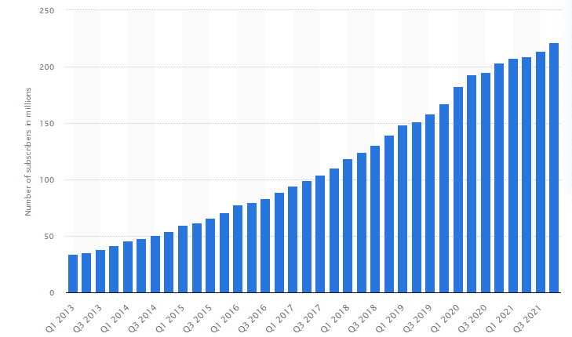
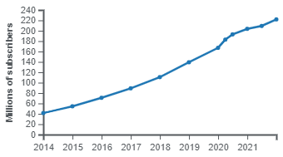
netflix user base
January 2022, 222 million subscribers worldwide
Annual revenue of $29 Billion USD in 2021

Slide 4
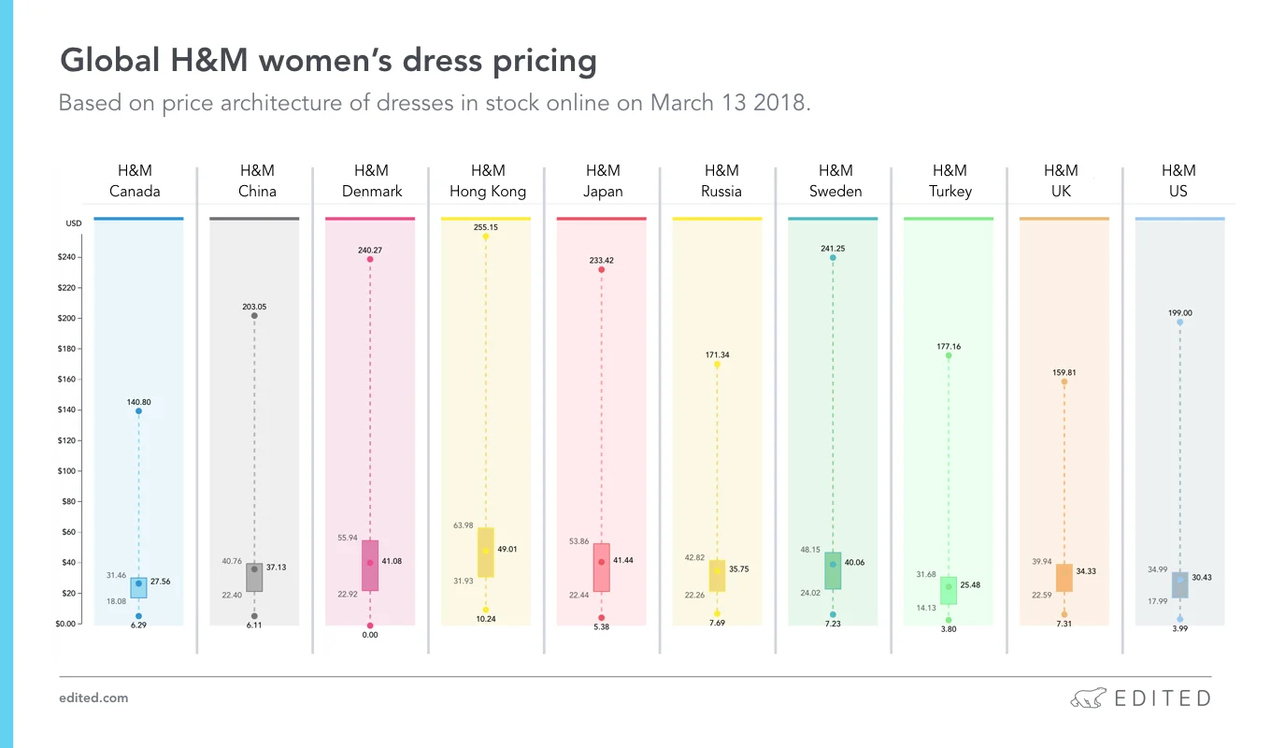
Motivators
Businesses operating internationally
Why exactly are prices almost always different in an international market?

Slide 5
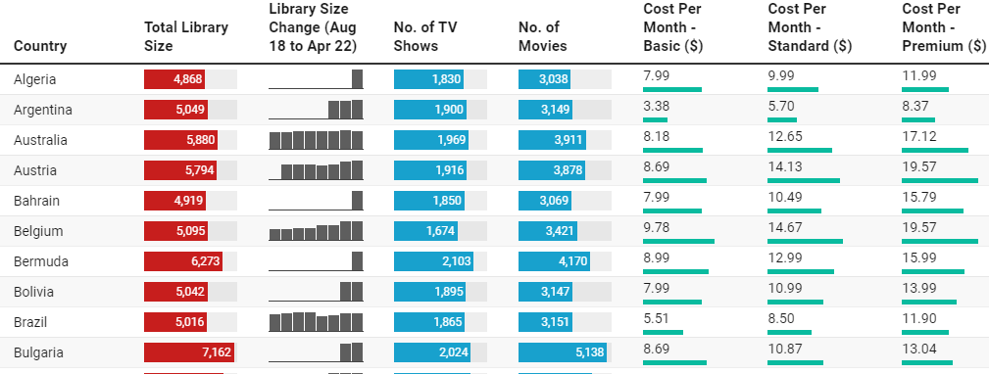
Motivators
Netflix in different countries
Experience of netflix in every country is different with different shows, prices & movies
Notes:
Understand why are we paying more and what are we paying for?

Slide 6

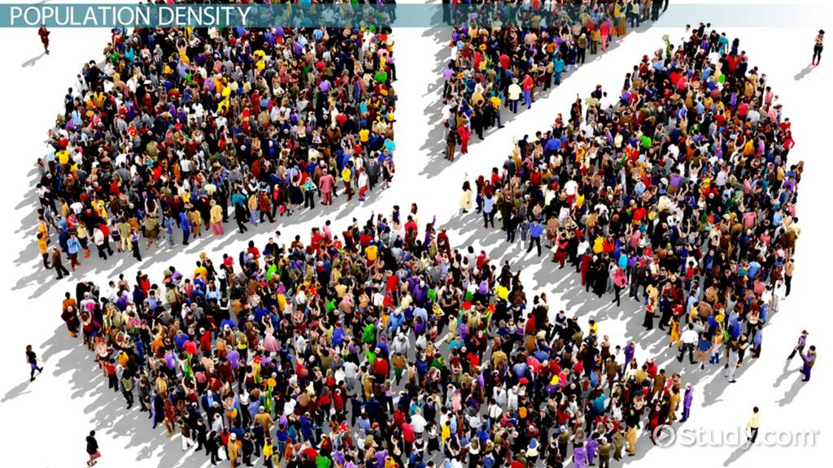

Some possible factors
Purchasing power/Income
Population Density
Library Size

Slide 7




Datasets
https://www.kaggle.com/datasets/prasertk/netflix-subscription-price-in-different-countries?select=netflix+price+in+different+countries.csv
https://www.kaggle.com/datasets/tanuprabhu/population-by-country-2020
https://www.kaggle.com/datasets/nitishabharathi/gdp-per-capita-all-countries

Slide 8
Data cleaning

Slide 9
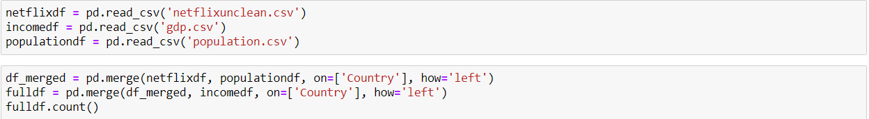
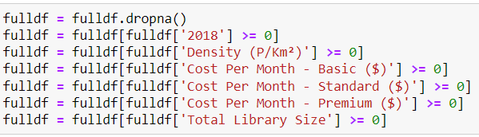
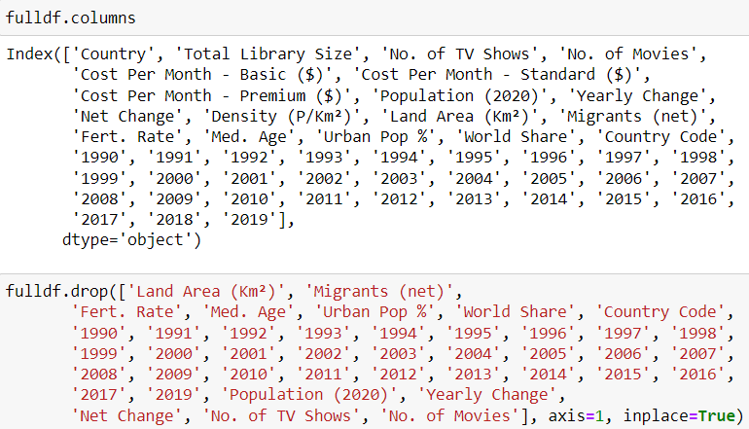
Data cleaning

Slide 10
Data cleaning
Kept | Removed
Country Total Library Size Cost per month - Basic($) Cost per month - Standard($) Cost per month - Premium($) Density (P/km^2) //Population density 2018 //Income | 1990~2017 //Income Land Area Migrants Fertility Rate Age Urban Population% World Share Country Code Population Yearly Change Net Change No. of TV Shows //Contributed to Library Size No. of Movies //Contributed to Library Size

Slide 11
Data Exploration

Slide 12
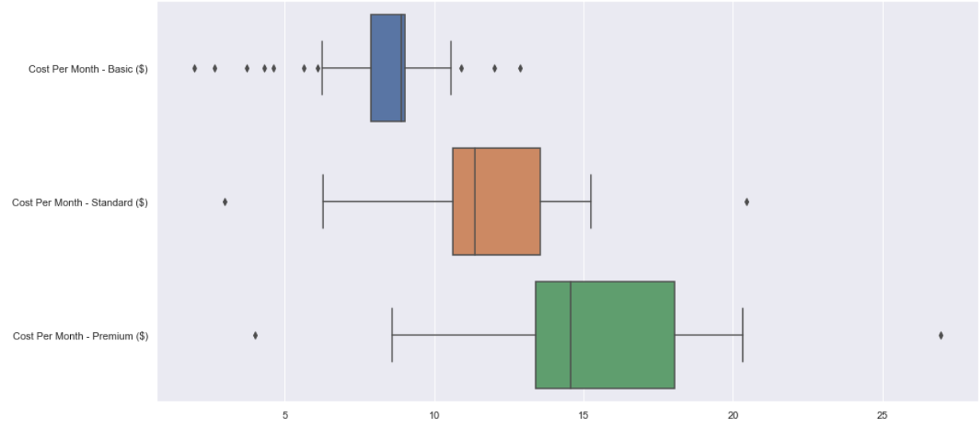
LOOKING AT OUR DATA
IQR: 7.9 -9.03
IQR: 10.6 - 13.5
IQR: 13.4 - 18.
Notes:
Using boxplots, here is an illustration of the subscription prices. the IQR ranges can be seen here.

Slide 13
How does the library size of netflix in each country affects its price?

Slide 14
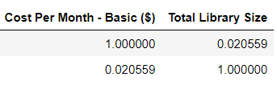
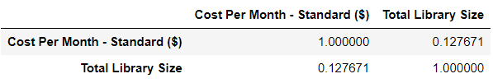
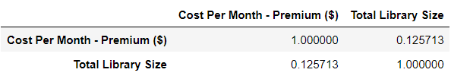
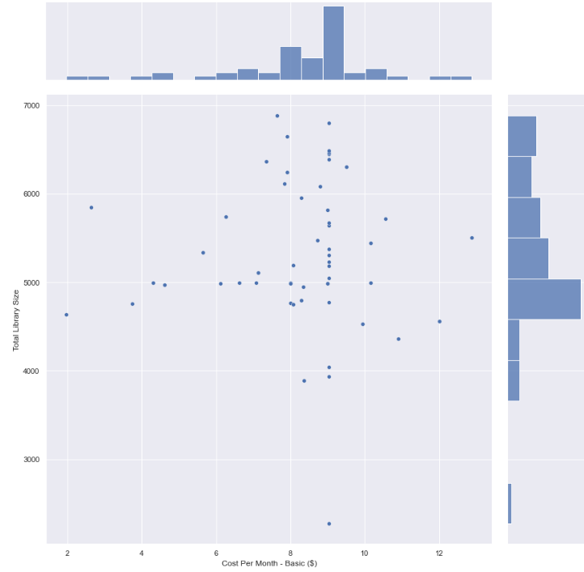
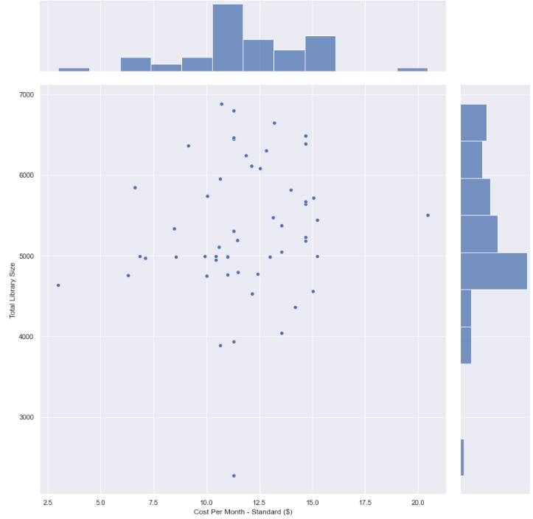
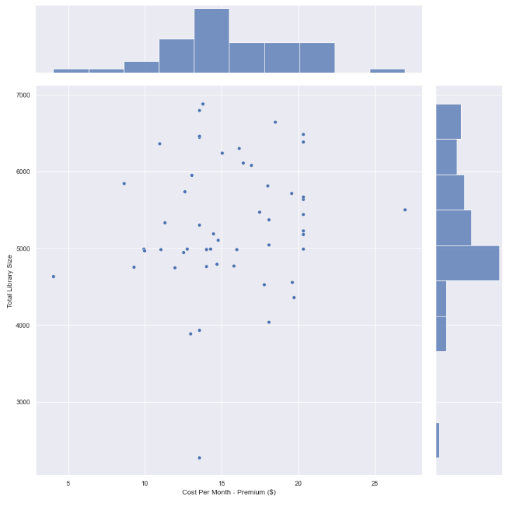
BASIC STANDARD PREMIUM
Notes:
We used jointplot here to look explore this. Looking at the plot and correlation values it seems like the value of the library sizes compared to the different subscription prices is quite insignificant and small because we’re getting 0.0 values

Slide 15
Does a country’s population density affect the price of netflix subscription?

Slide 16
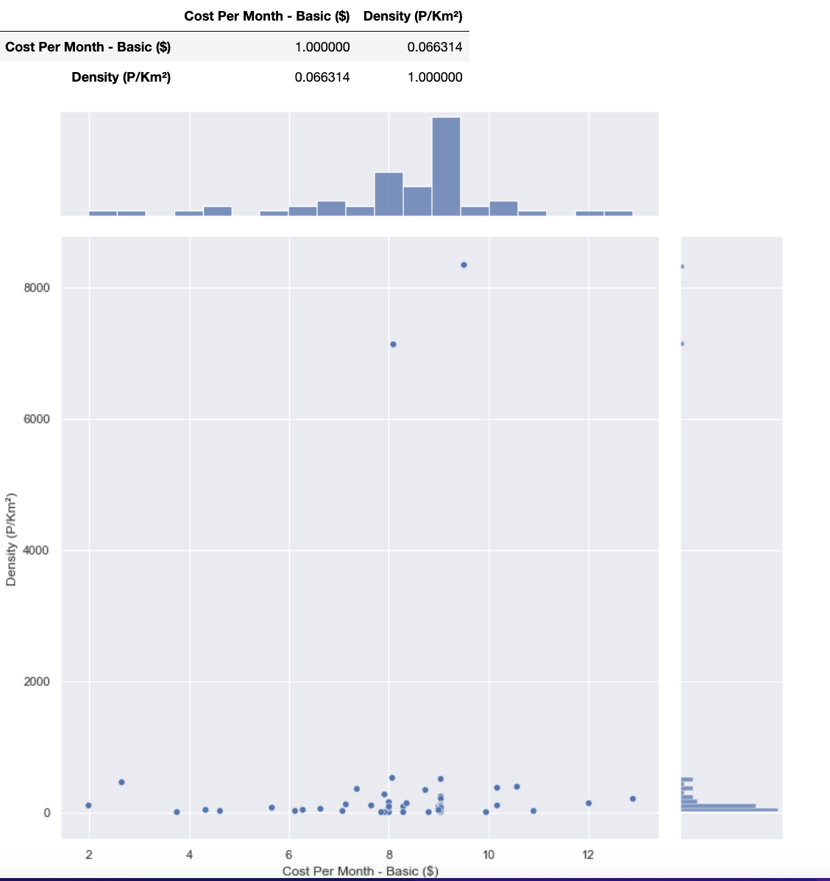
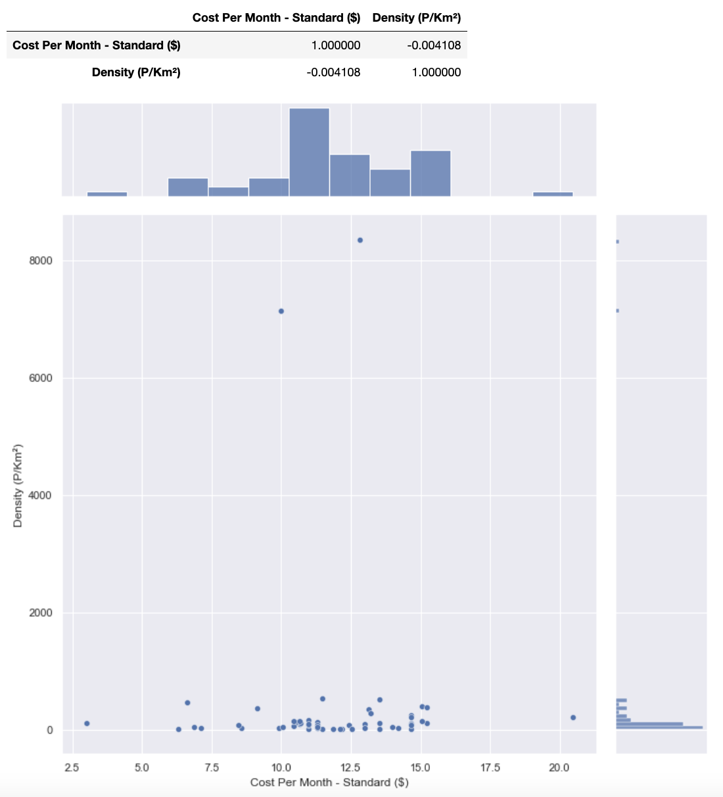
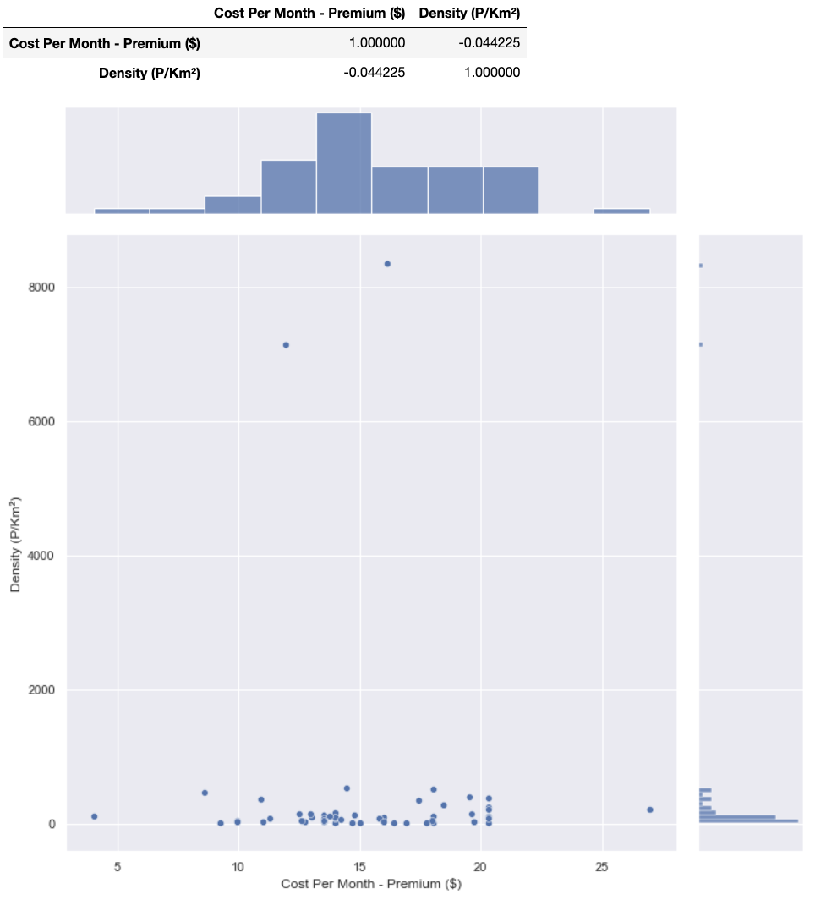
BASIC STANDARD PREMIUM
Notes:
Looking at the plots and correlation values again, seems like population density doesn’t have much effect on the subscription prices. it’s slightly higher than the values gotten compared to the library sizes as we’re getting the values of 0.1 but it’s not significant enough to say that it affects the subscription prices.

Slide 17
How does a country’s gdp affect the price of netflix subscription.?

Slide 18
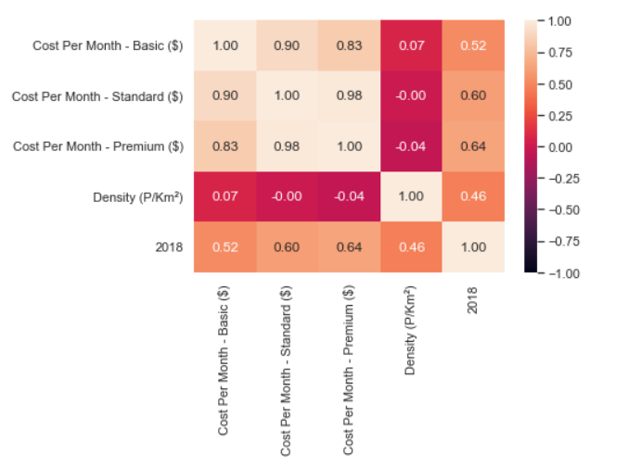
Correlation between GDP, Prices, and Population Density
Notes:
We looked at this through the use of a heat map. We can see that density has a low correlation value or none at all for all three subscription prices. GDP, labelled 2018, has somewhat a significant correlation value, all being above 0.5 towards the subscription prices.

Slide 19
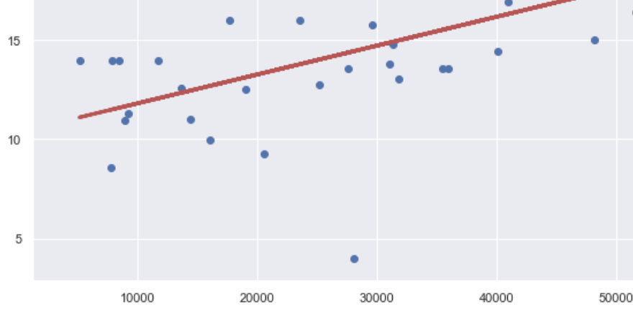
 | Basic cost | Standard cost | Premium cost
Intercepts | [6.01838513] | [8.39215105] | [10.35902564]
Coefficients | [[6.12046285e-05]] | [[9.74117271e-05]] | [[0.00014543]]
Values ranges by 10k for GDP
Notes:
We also used linear regression to approach this by looking at the intercept and coefficient values.
With the GDPs between countries varying by the tens of thousands, the coefficient values will also be greatly exaggerated. For a 10K increase in GDP, the cost of the plans increase by 10%, 11.6%, and 10% respectively, which is 10.5% on average. Therefore, we can conclude that the cost of the Netflix plans are directly related to a country’s GDP.

Slide 20
Machine Learning

Slide 21
Can the price of a netflix subscription be determined by just gDP and population density? (K-Nearest neighbour)

Slide 22
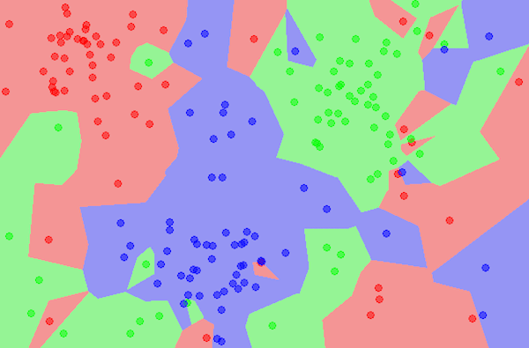
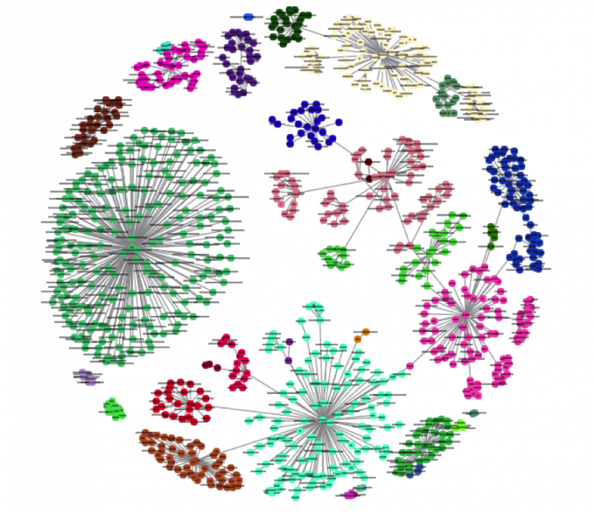
What is k-nearest neighbour
K-Nearest Neighbour Regression/Classification
“Bird of a feather flock together”
Supervised Learning Algorithm
Easy to learn & Effective
Notes:
KNN can solve regression and classification. Its also supervised learning algorithm
KNN works by finding the distances between a query and all the examples in the data,
selecting the specified number examples (K) closest to the query,
then votes for the most frequent label (in the case of classification) or averages the labels (in the case of regression).
In this case, we will only use KNN for regression.

Slide 23
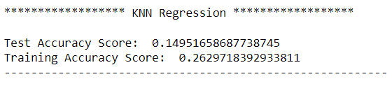
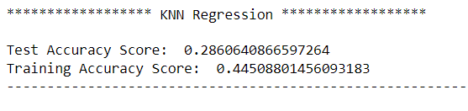
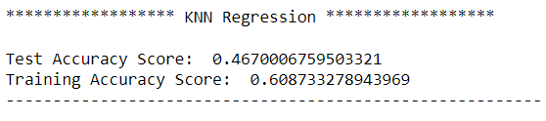
basic (K-value: 14)
STANDARD (K-value: 13)
Premium (K-value: 5)
Notes:
So we can see that every test accuracy score is lower than the training, this is good as there is no overfitting.Overfitting happens when the training model performs significantly better on the training data than on the test data. This is an unwanted behavior as our goal on creating a training model is to have a machine learning model that works well on both datas.
we can see from the basic and standard plans that both their training scores are considerably low while the premium plan, the training accuracy is 60.9% while the test accuracy is 46.7%. therefore, we can see that the machine is not able to reliably predict the cost of the the basic and standard plans from GDP and population density. meanwhile the machine can better predict the cost of the premium plan, although it’s accuracy is not optimal.
.

Slide 24
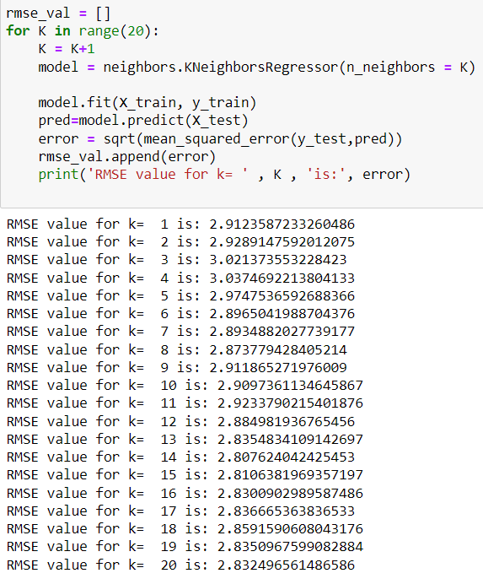
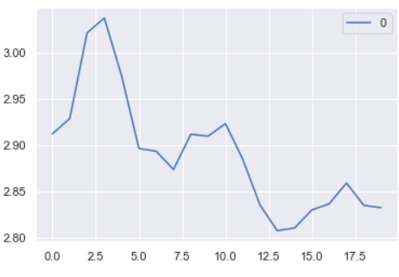
Choosing the right k-value
Notes:
K value indicates the count of the nearest neighbors.
. For us, we think choosing the right k value can be done through finding the least mean squared error. we’re doing this by using the loop as seen here. the lower the RMSE value is, the better the fit. Looking at our values for example, k=14 produces the lowest rmse value and thus the best fit. however, the RMSE value is still very high. as values between 0.2 and 0.5 can be said to predict data accurately. therefore, we can see that since the RMSE value is so much higher than the accepted range, the model is unable to reliably predict the data.

Slide 25
Can the price of a netflix subscription be determined by just gdP and population density? (Linear regression/ Ridge REGRESSION)

Slide 26
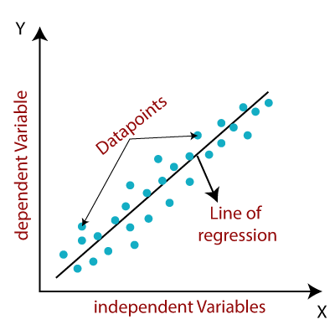
Linear Regression

Slide 27
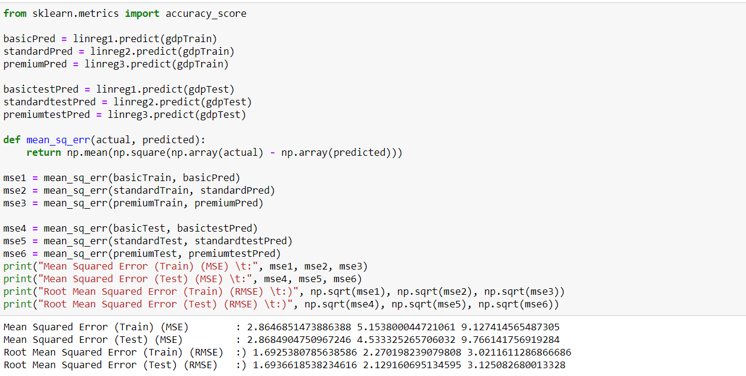
Checking for Overfitting by comparing MSE values between Train and test values

Slide 28
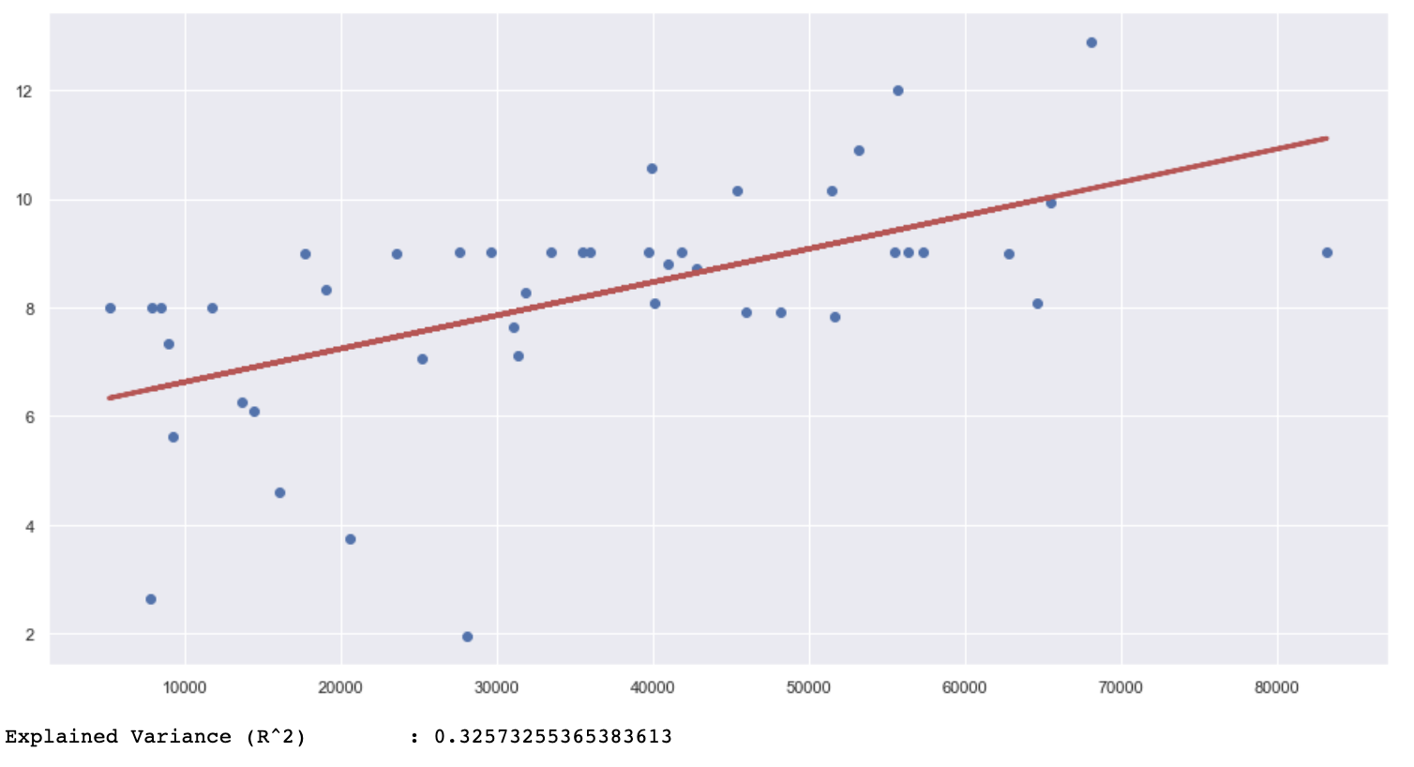
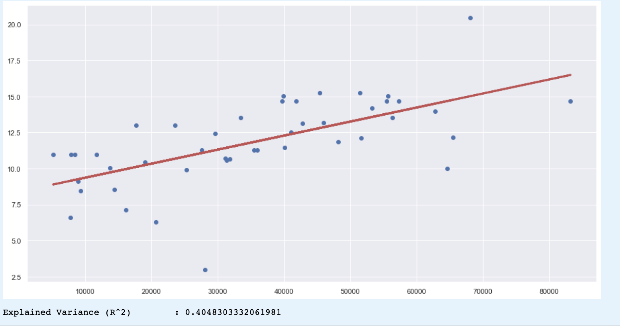
basic
STANDARD
Premium

Slide 29
Looking at R² values
 | BASIC | STANDARD | PREMIUM
R² value for GDP | 0.32573255365383613 | 0.4048303332061981 | 0.46121376160032745
R² value for Population density | 1.4348364674621195e-05 | 0.0060959147213383025 | 0.013565911841476819

Slide 30
Conclusion

Slide 31
Prices of netflix internationally
GDP is an important factor in pricing of Netflix or even goods internationally
Purchasing Power parity is not omnipotent as there are many other factors in play
Taxes, imports, competition, government, laws are all factors that need to be considered as well
Thus, we are unable to solve the question of “How are the prices of various Netflix subscriptions determined in a country?” as there are too many other considerations unknown to public

Slide 32
ThAnk you!

